Slide 1
Conditional Execution
Maryam Omar

Slide 2
Conditional Execution
Up to now, we have seen that instructions are executed unconditionally one after another.
What if you want to execute an instruction depending on a condition?
Selection: choose from among many options according to a criteria
E.g. If response is yes do this, else do that
E.g.
If year is a leap year, number of days is 366, else 365
You achieve conditional execution with if else statement
Sabanci University

Slide 3
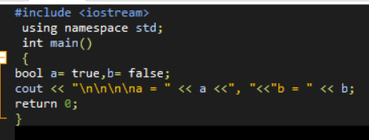
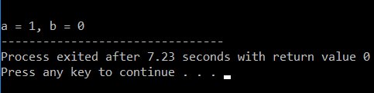
Type Bool
To understand conditional Execution we must understand non numeric data type bool
It can represent only two values: true and false
True means 1, false means 0
Code:
Output:

Slide 4
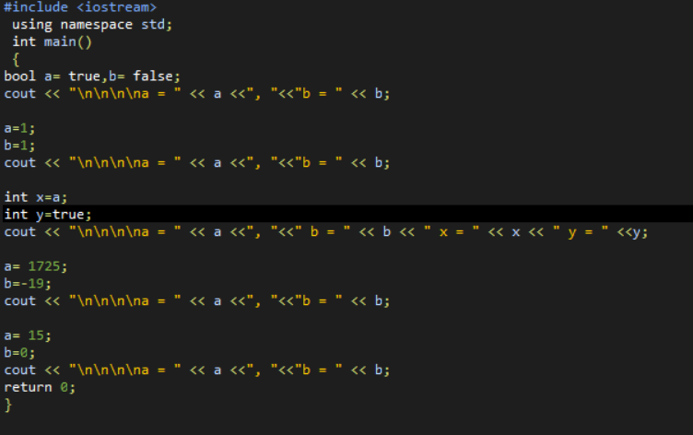
Task
What will be the output of given program:

Slide 5
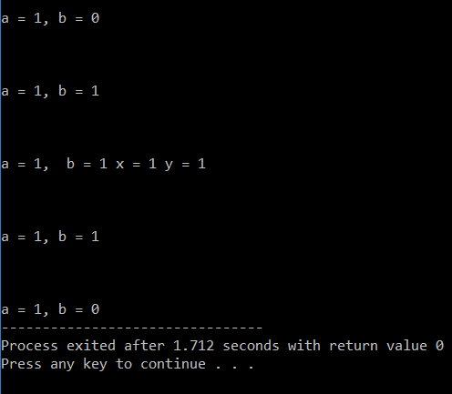
Output

Slide 6
If else statement
Syntax:
if (condition){
statement;
}
else{
statement;
}

Slide 7
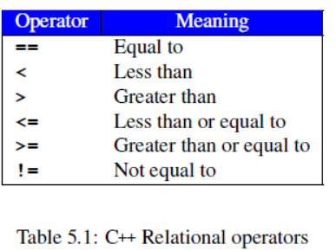
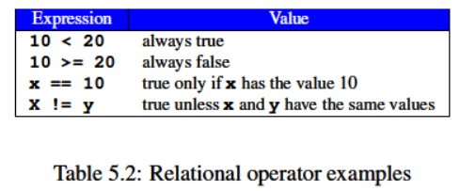
Relational Operators
An expression that results into true or false is called as Boolean expression
Comparisons for Boolean expressions are done by relational operators

Slide 8
Compound Statements
We can combine one Boolean expression, each involving one relational operator into more complex Boolean expression using logical operators and, or & not operators.
A combination of two or more Boolean expressions using two or more logical operators is called compound Boolean expression.

Slide 9
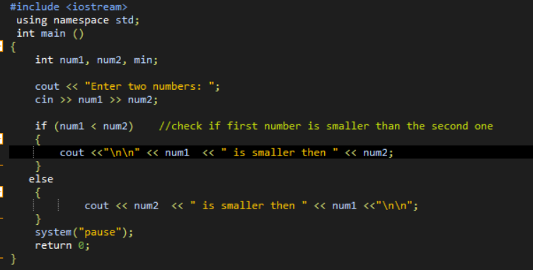
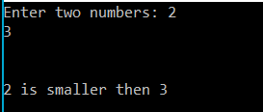
Task
Write a code that takes two inputs from users and shows the maximum number from them
Output:

Slide 10
Task
Write a code that divides two numbers. If 2nd number is zero, then it should give a message “divisor cannot be zero” to user.
Write a code that takes an integer as input from user, if entered number is even it should display the message that “number is even” else it should display “number is odd”
Write a code that takes an integer from user. Check that if entered number is in between or including 0 and 100,or not? If so, display a message saying that the number is in the range. If not, the message should say “out of the range”.

